Slide 1
Achievement and Uptake of STEM subjects at A level:
Ethnicity, Gender and SES
Presentation for the Royal Society
Loic Menzies – Director, LKMco cic. @LKMco
With thanks to the Social Mobility Commission and Philip Nye, Education Datalab
“Society should ensure that all children and young people receive the support they need in order to make a fulfilling transition to adulthood”
info@lkmco.org - +44(0)7793 370459 - @LKMco – www.lkmco.org.ukv

Slide 2
There is an SES gap in achievement in STEM A levels and it's there for all ethnicities but less so for Pakistani/Bangladeshi pupils.
Unlike for other subjects, there is almost no gender gap in achievement when it comes to STEM A levels, but there is a big one in uptake - particularly among White British and White Other pupils. The gap is smaller amongst Black pupils and ‘Other Asian’ pupils. Most STEM entries from Black pupils come from girls. This is because:
The gender gap is relatively narrow amongst this ethnic group (12% of girls’ A level entries are STEM cf. 15% of boys’ entries)
56% of black pupils’ A level entries overall (all subjects) are from girls.
Only a small proportion of A level entries from White and Black students are for STEM subjects (13-14% of entries), compared to other ethnic groups (17-18% for Pakistani/Bangladeshi and 'Any other' and a whopping 28% for 'Other Asian).
The SES gap in uptake exists among all ethnic groups but is particularly wide amongst White British pupils* (6% of White British FSM pupils’ entries cf. 13% of non FSM pupils’ entries).
*NB a far larger proportion of ethnic minority students are poor, both in terms of a larger proportion of them being FSM eligible and the 'non eligible' pupils tending to be poorer than white 'non eligible' pupils. You would therefore expect FSM and non FSM participation and achievement amongst ethnic minorities to be closer and for the ethnic group as a whole to perform more like its officially recognised 'disadvantaged pupils'.
“Society should ensure that all children and young people receive the support they need in order to make a fulfilling transition to adulthood”
info@lkmco.org - +44(0)7793 370459 - @LKMco – www.lkmco.org.ukv

Slide 3
1. Gender and attainment
Achievement is broadly comparable and has been for a while (with a bit of convergence)
”Society should ensure that all children and young people receive the support they need in order to make a fulfilling transition to adulthood”
info@lkmco.org - +44(0)7793 370459 - @LKMco – www.lkmco.org.uk

Slide 4
2. Ethnicity and achievement
Amongst those that take STEM A levels, achievement is comparable across ethnic groups – except for Black and Pakistani/Bangladeshi.
”Society should ensure that all children and young people receive the support they need in order to make a fulfilling transition to adulthood”
info@lkmco.org - +44(0)7793 370459 - @LKMco – www.lkmco.org.uk

Slide 5
3. SES and attainment
Even amongst the small subset of FSM pupils who take A levels and chose to take STEM subjects, achievement is lower. Consistently ~8% lower.
”Society should ensure that all children and young people receive the support they need in order to make a fulfilling transition to adulthood”
info@lkmco.org - +44(0)7793 370459 - @LKMco – www.lkmco.org.uk

Slide 6
4. Ethnicity, gender and attainment
Gender gaps in attainment are consistently small amongst most ethnic groups though slightly larger amongst Pakistani/Bangladeshi and Other Asian
”Society should ensure that all children and young people receive the support they need in order to make a fulfilling transition to adulthood”
info@lkmco.org - +44(0)7793 370459 - @LKMco – www.lkmco.org.uk

Slide 7
5. Gender, SES and attainment
FSM males achieve 2% more highly than FSM females
”Society should ensure that all children and young people receive the support they need in order to make a fulfilling transition to adulthood”
info@lkmco.org - +44(0)7793 370459 - @LKMco – www.lkmco.org.uk

Slide 8
6. Ethnicity, SES and attainment
The SES gap exists across all ethnic groups (6-8%) though it is narrower amongst Pakistani/Bangladeshi pupils (3%).
”Society should ensure that all children and young people receive the support they need in order to make a fulfilling transition to adulthood”
info@lkmco.org - +44(0)7793 370459 - @LKMco – www.lkmco.org.uk

Slide 9
7. Gender and uptake of STEM subjects
Well over half of STEM A level entries come from males, despite the fact that more than half of A level entries (for all subjects) are from females.
”Society should ensure that all children and young people receive the support they need in order to make a fulfilling transition to adulthood”
info@lkmco.org - +44(0)7793 370459 - @LKMco – www.lkmco.org.uk

Slide 10
8. Ethnicity and uptake of STEM subjects
White British, White other and black students enter STEM A levels at a low rate, particularly compared to ‘Other Asian’ Students
”Society should ensure that all children and young people receive the support they need in order to make a fulfilling transition to adulthood”
info@lkmco.org - +44(0)7793 370459 - @LKMco – www.lkmco.org.uk

Slide 11
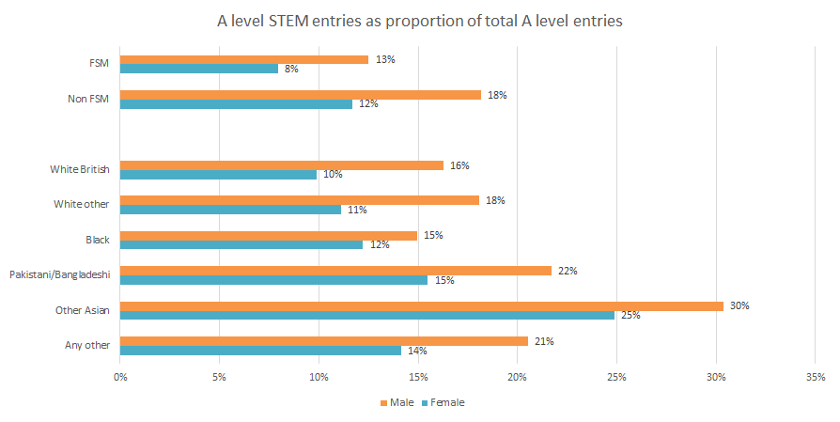
9. Ethnicity, SES, gender and uptake of STEM subjects
Gender gaps are large for each ‘intersection’ but smallest for ‘Other Asian’ and Black pupils
”Society should ensure that all children and young people receive the support they need in order to make a fulfilling transition to adulthood”
info@lkmco.org - +44(0)7793 370459 - @LKMco – www.lkmco.org.uk

Slide 12
10. Ethnicity, gender and uptake of STEM subjects
Particularly high rates of A level participation amongst black girls relative to black boys mean that most STEM A level entries from black pupils actually come from black girls.
”Society should ensure that all children and young people receive the support they need in order to make a fulfilling transition to adulthood”
info@lkmco.org - +44(0)7793 370459 - @LKMco – www.lkmco.org.uk

Slide 13
11. Ethnicity, SES and uptake of STEM subjects
The SES gap in uptake of STEM subjects as proportion of A level entries (the SES skew) is by far the largest amongst White British pupils and much smaller amongst black pupils, but there is also a large gap amongst ethnic groups like ‘Other Asian’ that take STEM subjects in large numbers
”Society should ensure that all children and young people receive the support they need in order to make a fulfilling transition to adulthood”
info@lkmco.org - +44(0)7793 370459 - @LKMco – www.lkmco.org.uk

